Slide 1
OTP Verification
Secure Authentication System By MANJUNATHA

Slide 2
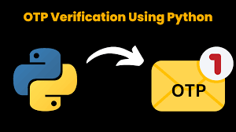

Slide 3
Title: Problem Statement
Content:
Develop a system to generate a 6-digit OTP.
Send OTP to the user’s email for verification.
Validate user-entered OTP.
Grant or deny access based on OTP verification.

Slide 4
Project Requirements
Content:
Generate a 6-digit OTP.
Send OTP to user's email.
Prompt user for OTP input.
Validate entered OTP.
Include error handling and user prompts.
Allow retries for incorrect OTP.

Slide 5
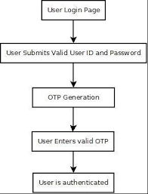
System Workflow
Flowchart: Start → Generate OTP → Send OTP to Email → User Inputs OTP → Validate OTP→ Grant/Deny Access

Slide 6
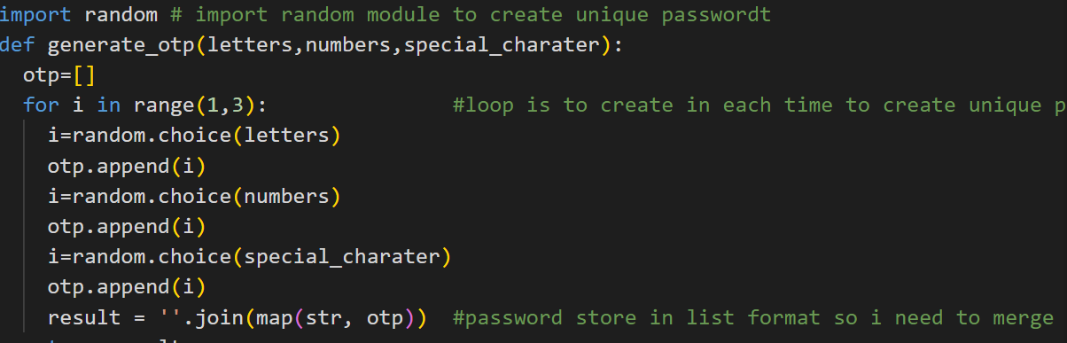
Generates a 6-digit OTP using random intEGERS,LETTERS,SPECIAL_CHARACTERS
OTP Generation :

Slide 7
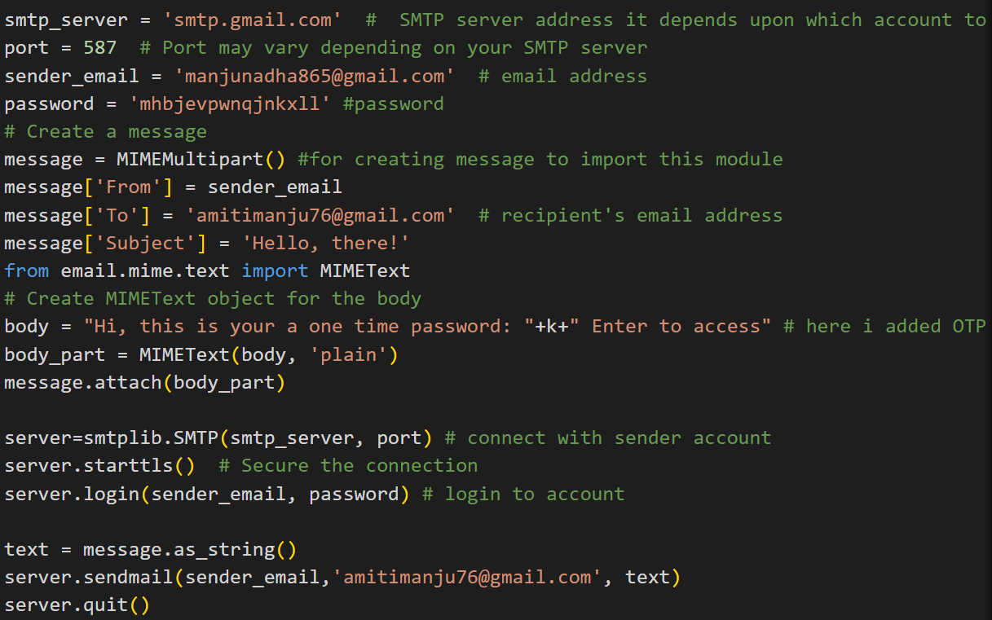
Sending OTP :
Code Snippet :

Slide 8
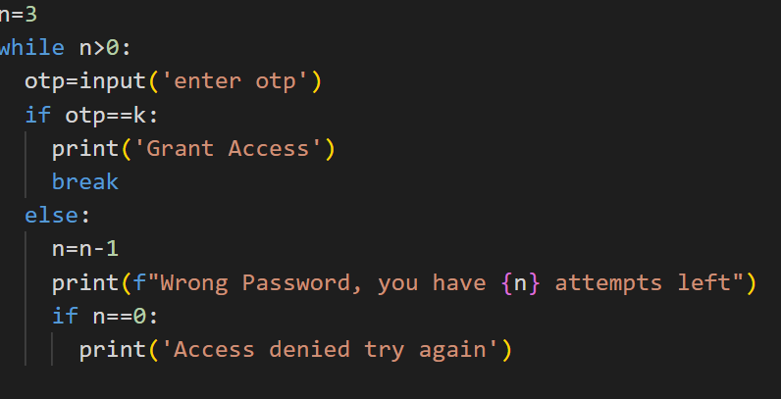
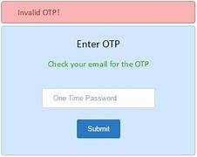
OTP Input and Validation

Slide 9
Project Deliverables
Content:
Python script with OTP generation and validation.
Documentation of functions and how to run the program.
Test cases for various scenarios.

Slide 10
Future Improvements
Content:
Two-Factor Authentication: Add a secondary verification method.
Encryption: Secure OTP transmission.

Slide 11

Thank you for your attention!

